Slide 1

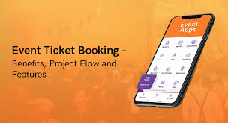
Event & Ticket
Booking System
By : Vijay Sai Nunna
ID : ZPVN-10116

Slide 2

Abstract
The Event & Ticket Booking System is a web-based application designed to simplify event management and ticket reservations. The system enables admins to create, manage, and approve events and venues, while users can register, log in, explore events, and book tickets seamlessly. Built with FastAPI for high-performance backend development and MongoDB (async with Motor) for scalable data storage, the system ensures efficient handling of concurrent requests.
The project integrates JWT-based authentication to provide secure login, role-based access (admin/user), and session management. Pydantic models are used for strict data validation, while centralized logging and exception handling ensure maintainability and traceability. The architecture follows a modular design, separating routers, services, models, and utilities for clarity and scalability.
This system demonstrates the implementation of real-world backend practices including asynchronous programming, password hashing with Passlib, sequence-based ID generation, and structured database indexing. It can be extended to handle large-scale events such as concerts, workshops, and seminars, offering a reliable and secure platform for both event organizers and participants.
PPT Deck Name

Slide 3
Introduction
The Event & Ticket Booking System is a web-based application designed to simplify the process of managing events and ticket reservations. The system provides a role-based architecture where:
Admins are empowered to register, log in, create and manage events and venues, approve or reject bookings , and monitor overall user activity. This ensures that event management is seamless, controlled, and transparent.
Users can register, log in, browse events based on title, category, and book tickets conveniently. They can also view, manage, or cancel their bookings, making the experience fully user-friendly.
Built using FastAPI for backend services and MongoDB (async) for database operations, the project ensures security, scalability, and performance. It integrates JWT authentication, logging, and exception handling to deliver a robust, real-time ticket booking platform.
This system aims to replace manual processes with an automated, efficient, and user-friendly digital solution.
PPT Deck Name

Slide 4
Learning Journey
Training Learnings | Project Learnings
Python with FastAPI & Flask | Built a complete REST API backend for event ticket booking with modular routers & services.
MongoDB (sync & async with Motor) | Designed scalable database models for Users, Admins, Events, Venues & Bookings with async queries.
JWT (JSON Web Tokens) | Implemented secure authentication & role-based access control (Admin/User).
Asynchronous vs Synchronous Programming | Applied async services for bookings, events, and venue management to optimize performance.
Web Security: Authentication & Password Hashing | Used Passlib for password hashing, and secure login/logout flows with token validation.
Logging & Exception Handling | Implemented centralized logging system and custom exception classes for clean error handling.
Schema Validation with Pydantic | Defined request/response models for Users, Admins, Events, Venues, and Bookings with strict validation.
Software Architecture & Modularization | Designed layered architecture (routers → services → database → utils) for clean maintainability.
Deployment & Config Management | Configured environment with .env, config.py, and Mongo Atlas connection for real-time database access.
PPT Deck Name

Slide 5



Objectives
Develop a secure and scalable event & ticket booking system.
Enable admins to manage events and venues efficiently.
Allow users to browse events and book tickets seamlessly.
For cancel and rejection of seats the seats will roll back to the database
Implement role-based access and JWT authentication.
Ensure real-time ticket availability and prevent overbooking.
Centralize data management with logging and exception handling.
PPT Deck Name

Slide 6
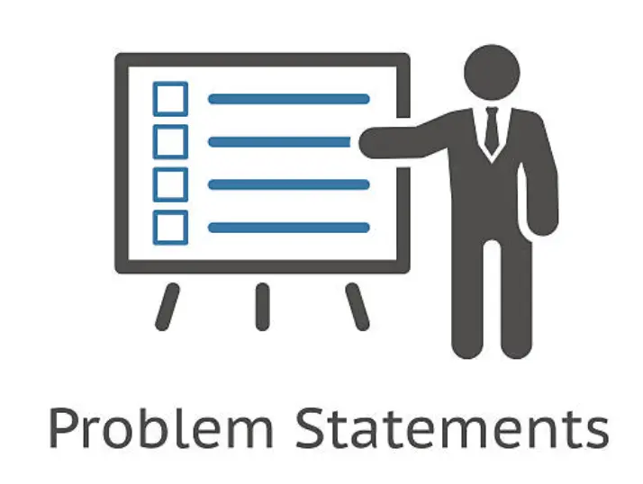
Problem Statement
Managing events and ticket bookings manually is inefficient, error-prone, and lacks transparency. Existing systems often fail to provides:
CRUD operations of Admin and Users accounts (Create, Update, Read, Delete)
Secure authentication for users and admins.
Real-time seat availability tracking.
Centralized management of events, venues, and bookings.
Scalability to handle multiple users and concurrent bookings.
There is a need for a digital, secure, and scalable event ticket booking system that streamlines event creation, venue management, and ticket reservations while ensuring a smooth experience for both users and administrators.
PPT Deck Name

Slide 7
Project Overview
The Event & Ticket Booking System is a web-based application developed to automate and simplify the process of managing events and ticket reservations. It serves as a centralized platform for both event organizers (admins) and participants (users), ensuring efficient, secure, and real-time operations.
Key Highlights:
Role-Based System:
Admins: Can register, log in, create and manage events, approve venues, and monitor user activity.
Users: Can register, log in, browse events, book tickets, and manage their bookings.
Technology Stack:
Backend: FastAPI – for high-performance, asynchronous API development
Database: MongoDB (async with Motor) – for scalable, non-blocking data storage
Authentication & Security: JWT-based authentication and password hashing with Passlib
Functionalities: Centralized management of events, venues, and bookings .Real-time seat availability to prevent overbooking .Secure login and role-based access control.Logging and exception handling for maintainability .Modular architecture separating routers, services, models, and utilities

Slide 8
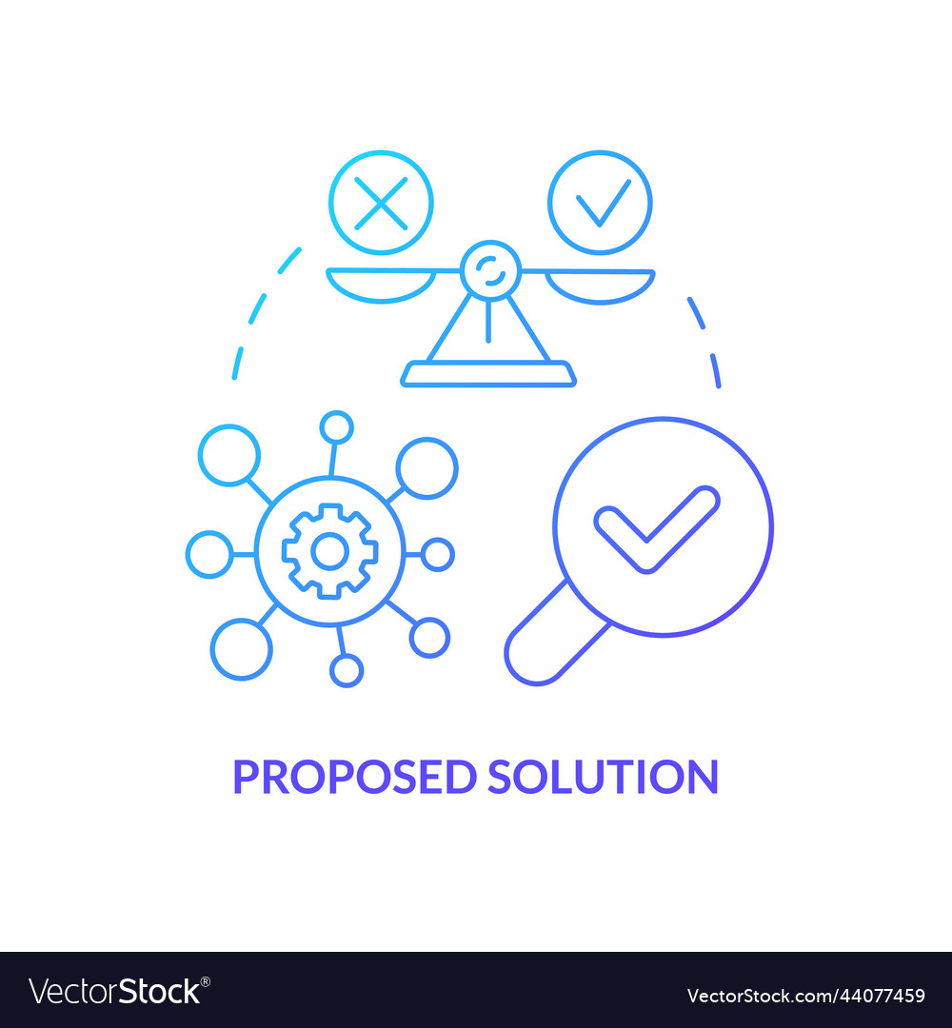
Proposed Solution
To address the challenges of manual event management and ticket booking, the Event & Ticket Booking System proposes a digital, secure, and scalable solution that streamlines the entire process for both administrators and users.
Key Elements of the Solution:
1. Role-Based Access Control:
Admins and users have distinct functionalities.
Ensures that only authorized personnel can create/manage events or approve venues.
2. Automated Event and Ticket Management:
Admins can create, update, and delete events.
Users can browse events, view details, and book tickets online.
Real-time seat availability prevents overbooking and ensures smooth booking.
PPT Deck Name

Slide 9
3. Secure Authentication:
JWT-based authentication ensures secure login and session management.
Passwords are hashed using Passlib for data protection.
4.Centralized and Scalable Database:
MongoDB (async with Motor) allows efficient data storage and retrieval.
Structured collections for users, events, venues, and bookings ensure organized data.
Supports multiple concurrent users and large-scale events.
5. Modular and Maintainable Architecture:
Separation of routers, services, models, and utilities.
Centralized logging and exception handling for easy monitoring and debugging.
6. User-Friendly Interface:
Simple browsing, searching, and booking process for users.
Smooth, seamless experience for event organizers and attendees.
PPT Deck Name

Slide 10
Project Workflow
The workflow of the Event & Ticket Booking System illustrates how different roles interact with the system and how processes flow from event creation to ticket booking:
1. User & Admin Registration/Login
Both users and admins register on the platform.
Secure login is handled via JWT-based authentication.
Role-based access ensures users and admins access only their permitted functionalities.
2. Admin Actions
Admin logs in and can:
Create, update, or delete events.
Approve or reject venues submitted for events.
Monitor user activity and manage bookings.
All actions are recorded via centralized logging.
3. Event Browsing & Searching (User Side)
Users log in and browse events based on:
Title, ID or category.
Event details include venue information, available seats, and timing.
PPT Deck Name

Slide 11
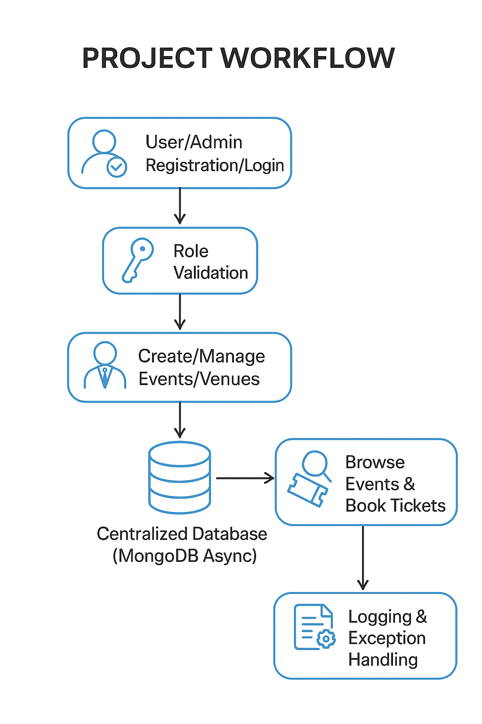
4. Ticket Booking Process
Users select an event and choose the number of tickets.
Real-time seat availability ensures no overbooking.
Upon confirmation, booking is stored in MongoDB with a unique ID.
5. Booking Management
Users can view, update, or cancel their bookings.
Admins can monitor all bookings and track attendance.
6. Security & Data Handling
All sensitive data (passwords, sessions) are securely handled.
Asynchronous database operations ensure high performance and scalability.
7. Logging & Exception Handling
Errors and system activities are logged for debugging and traceability.
Ensures smooth functioning and maintainability of the system.

Slide 12
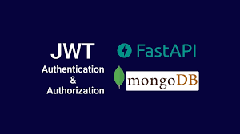

Tech Stack
Backend: Python + FastAPI for high-performance APIs.
Database: MongoDB with async support (Motor).
Authentication: JWT (JSON Web Token)
Security: Passlib (Password Hashing)
Data Validation : Pydantic for data consistency.
Logging & Errors: Centralized Logging & Exception Handling
Design : Asynchronous, scalable, and modular.
PPT Deck Name

Slide 13
Core Management Modules
1. User Management Module:
Purpose: Manage users and their activities.
Features:
User registration & login
Profile management
Password reset & change
Role-based access (User/Admin)
Session management (JWT-based)
2. Admin Management Module
Purpose: Control overall system operations.
Features:
Admin registration & login
Approve/reject user actions
View reports and system logs
Assign roles and permissions
PPT Deck Name

Slide 14
3. Event Management Module
Purpose:Manage events from creation to completion.
Features:
Create, edit, and delete events(only admins)
Assign event dates, venues, and capacity(only admins)
Event status management (active, canceled)
Event categorization (workshop, concert, seminar, etc.)
4. Venue Management Module
Purpose:Handle event venues and seating arrangements.
Features:
Add, edit, and remove venues(admins)
Manage venue capacity and location(admins)
Approve venue requests(admins)
Track seat availability
PPT Deck Name

Slide 15
5. Ticket Booking Module
Purpose: Allow users to reserve seats/tickets.
Features:
Browse events and available seats
Real-time seat availability check
Book and cancel tickets
Generate unique ticket IDs
6. Logging & Exception Handling Module
Purpose:
Ensure maintainability, traceability, and debugging.
Features:
Centralized logging for system activities
Exception handling for API requests
Error notifications for admins
PPT Deck Name

Slide 16
API Endpoint Overview
Accessed Tokens | Endpoints | Count endpoints
Users Accessed Endpoints | User---Register-user, Login-user, Get-user-info, Update-user, Logout-user Delete –user(with user token) Events---Get-all-events, Get-evet-by-id, Get-event-by-type Venue--- Get-venue-by-id , Get-venue-by-type, Get-all-venues Bookings---Book-Seats, Get-user-bookings-info, Cancel-Bookings | 6 Endpoints 3 Endpoints 3 Endpoints 3 Endpoints
Admin Accessed Endpoints | Admin ----Register-Admin, Login-admin, Get-admin-info, Get-all-Users, Get-all-admins, Update-admin, Delete-admin, Logout-admin Events---Create-Event, Update-Event, Delete-Event, Get-all-events, Get-evet-by-id, Get-event-by-type Venue---Create-Venue, Update-Venue, Delete-Vneue, Get-venue-by-id , Get-venue-by-type, Get-all-venues Bookings ---Get-all-user-bookings, Approve-Booking, Reject-Booking | 8 Endpoints 6 Endpoints 6 Endpoints 3 Endpoints
PPT Deck Name

Slide 17

Key Features
Asynchronous FastAPI Backend – High-performance API design.
MongoDB Integration – Efficient storage and retrieval with batch-wise inventory..
Centralized Exception Handling – Custom exception handling & logging.
Scalable & Modular Design – Easy to extend with new features.
Secure JWT-based login.
Role-based access (Admin/User).
CRUD for Events, Venues, Users, Bookings.
Real-time booking & seat validation.
Centralized exception handling & logging.
Sequence-based IDs for entities.
PPT Deck Name

Slide 18
Project Learnings & Outcomes
Developed modular APIs using FastAPI for clean and maintainable code.
Implemented asynchronous database operations with MongoDB (Motor) for better performance.
Built a role-based JWT authentication system for secure access control.
Applied logging, exception handling, and input validations for reliability.
Learned RESTful API design principles for efficient communication between admin and user.
Managed user profiles, bookings, and events programmatically.
Gained experience in integration of backend for real-time updates.
Enhanced debugging and problem-solving skills in real-world scenarios.

Slide 19

Future enhancements
Payment Gateway Integration – Enable secure online payments to make ticket booking seamless for users.
Multi-location Events & Ticket Categories – Support events across multiple venues with different ticket types and pricing.
Real-time Notifications – Send instant alerts to users about event updates, cancellations, or new event launches.
Mobile App Interface – Develop a mobile application for iOS and Android to provide users with on-the-go access.
Analytics Dashboard for Admins – Implement dashboards to track ticket sales, user engagement, and event performance for better decision-making.
PPT Deck Name

Slide 20

Achievements & Impact
Successful Implementation: Developed a fully functional Event Ticket Booking System from scratch.
User Convenience: Simplified event discovery, booking, and management for users.
Approve ,Reject(admin) and Cancel(user) of bookings: Successfully Seats roolback after the rejection and cancellation of seats bookings .
Enhanced Security: Integrated role-based JWT authentication for secure access control.
Technical Growth: Gained hands-on experience with FastAPI, MongoDB, async operations, and scalable backend design.
PPT Deck Name

Slide 21
Conclusion
Automated, Secure, and Efficient: The system streamlines the event booking process, ensuring fast and reliable ticket management with secure user access.
Simplified Management: Both users and admins can easily manage bookings, events, and profiles, reducing manual effort and errors.
Scalable and Maintainable Architecture: The backend is designed to handle growing user traffic and future feature expansions without compromising performance.
Practical Learning and Implementation: The project demonstrates real-world backend development practices, including modular API design, asynchronous database operations, role-based authentication, and robust error handling.
The project highlights key technical skills such as API development with FastAPI, asynchronous database operations, role-based authentication, and scalable backend design.

Slide 22
Thank You

